Slide 1
Tacoma Power Resource Planning
Greg Brunkhorst
gbrunkhorst@cityoftacoma.org
Tacoma Power – Integrated Resources Planning
Tacoma Public Schools Presentation to Physics Teachers
3/18/2025
Rachel Clark
Tacoma Power – Integrated Resources Planning

Slide 2
Agenda
Tacoma Power Facts
Power Generating Resources
Lesson Link and Grid
Power Planning at Tacoma Power

Slide 3
Tacoma Power Facts

Slide 4

Presenter
Skin in the Game
Tacoma Power Employee – Integrated Resources Planning
Tacoma Power Rate Payer
Two kids in Tacoma Public Schools – Stadium HS and Grant Elementary
Career
Open-source programming enthusiast (Python)
Hydropower modeling
Statistics, machine learning, linear optimization
Former environmental engineer (15 years)
Former high school teacher (1 year)

Slide 5
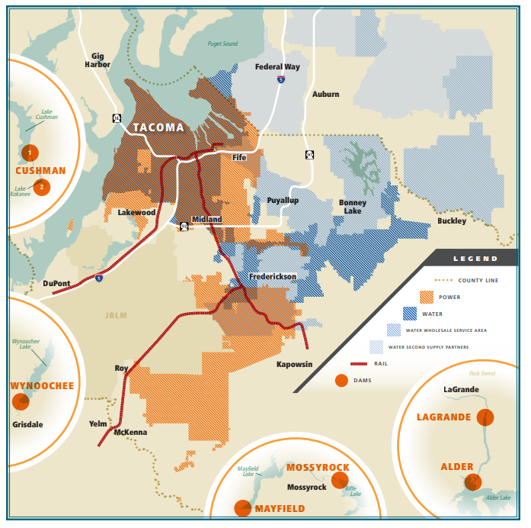
Tacoma Power Service Area
180,000 customers
180 square miles of service area
Cities of Tacoma, Fircrest, University Place, Fife, parts of Steilacoom, Lakewood, Joint Base Lewis-McChord, and unincorporated Pierce County as far south as Roy

Slide 6
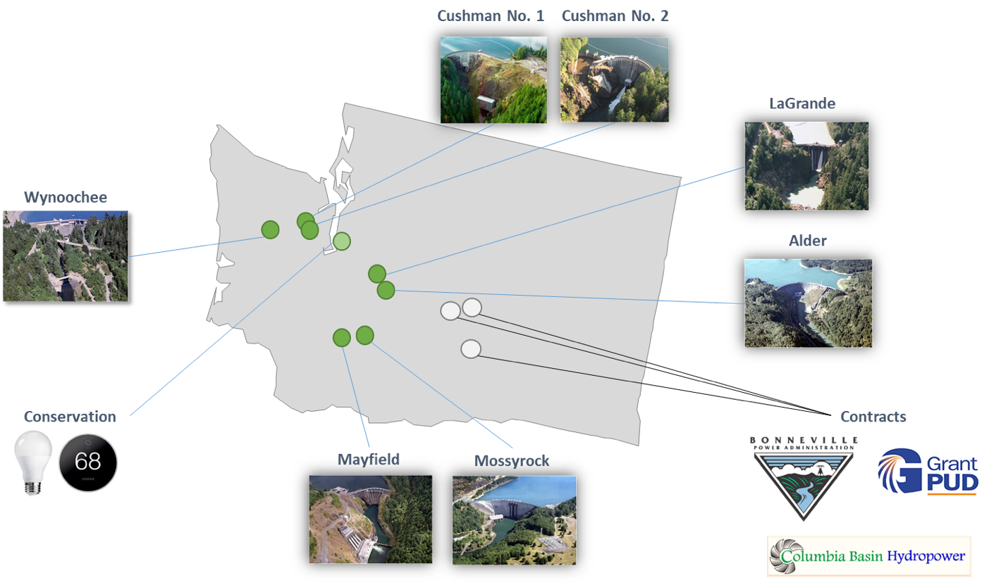
Our power resources
Nisqually River Project
Cowlitz River Project
Notes:
Our power supply consists of the output from four hydroelectric projects that are owned by Tacoma Power and power that the utility purchases from other parties. The largest amount of purchased power comes from the Bonneville Power Administration.
The four hydro electric projects that Tacoma owns are Cowlitz and Nisqually in the Cascades and Cushman and Wynoochee in the Olympics.
Conservation has been one of the only resources we have acquired in many years

Slide 7
Tacoma Power Hydro History
1893: Tacoma citizens voted to purchase the privately-owned Tacoma Light & Water Company, establishing public ownership of the utility
1912: The 24-MW LaGrande Powerhouse on the Nisqually River began delivering electricity, making Tacoma independent of private power sources
1920s: Tacoma Power built the two-powerhouse Cushman Hydroelectric Project
1945: Tacoma Power upgraded the Nisqually River Project, built Alder Dam and LaGrande Dam
1963: Mayfield Dam on the Cowlitz River was completed and began generating electricity
1968: Mossyrock Dam on the Cowlitz River was completed.
1994: Tacoma Power created the Wynoochee River Project by building a powerhouse downstream from the Wynoochee Dam.

Slide 8
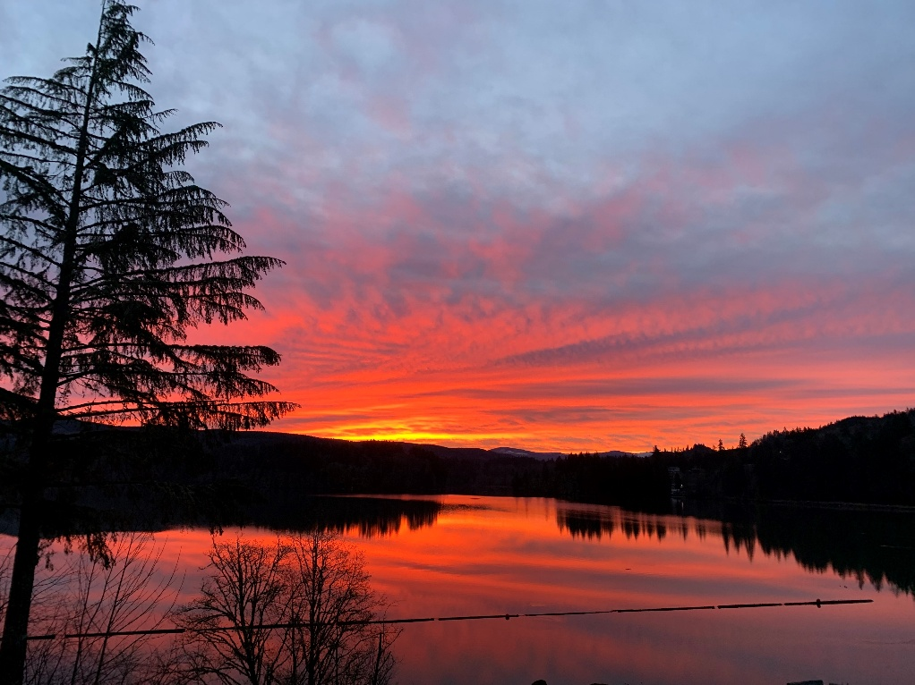
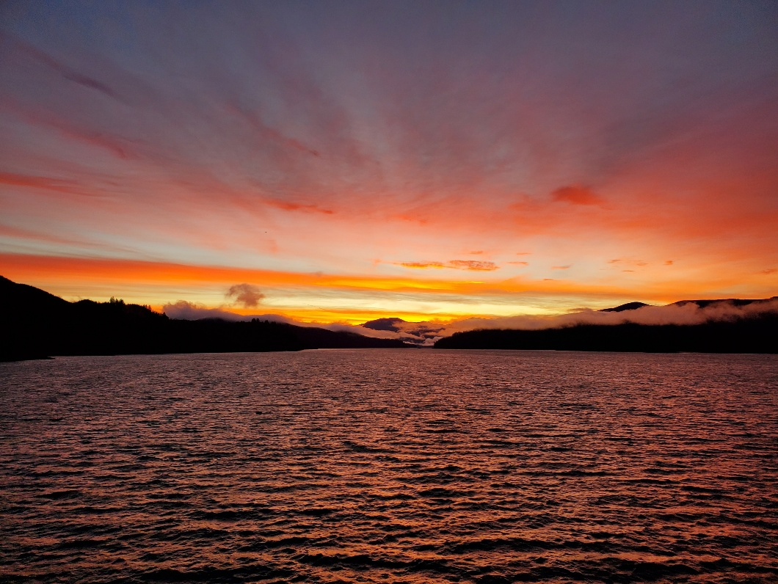
Plant Intake and Reservoir
Notes:
The left photo is of the Mayfield Reservoir
The right is of Riffe

Slide 9
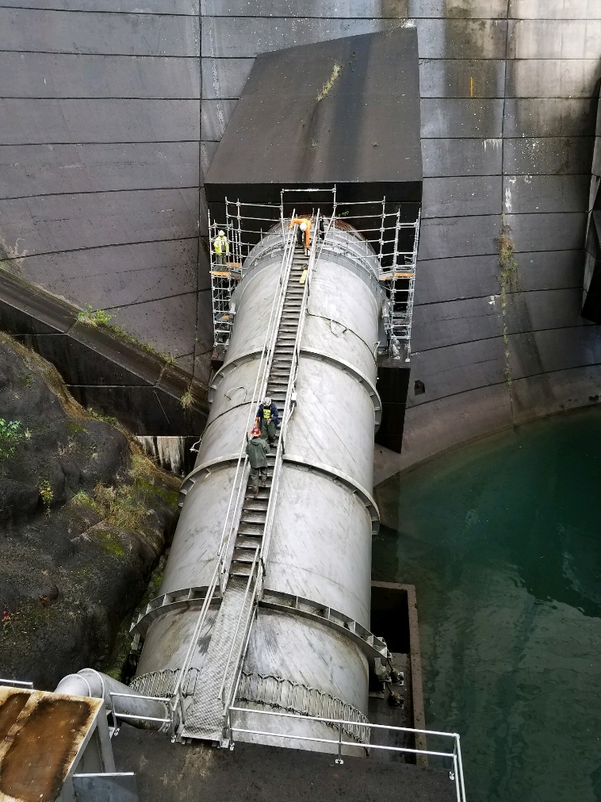
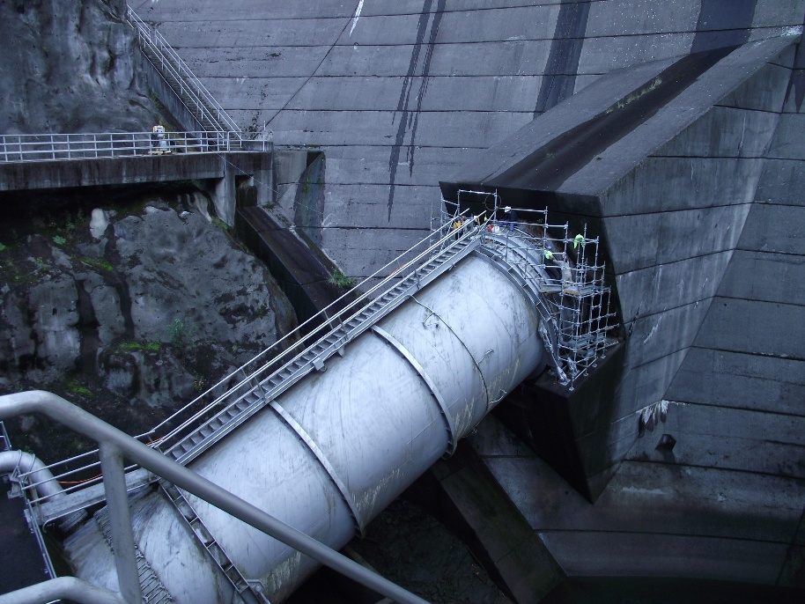
Penstocks
Notes:
This is one of the Mossyrock Penstock, its 21 ft in diameter, can flow over 7000 Cubic Feet of water per second, a good visual is about 7000 basketballs per second.

Slide 10
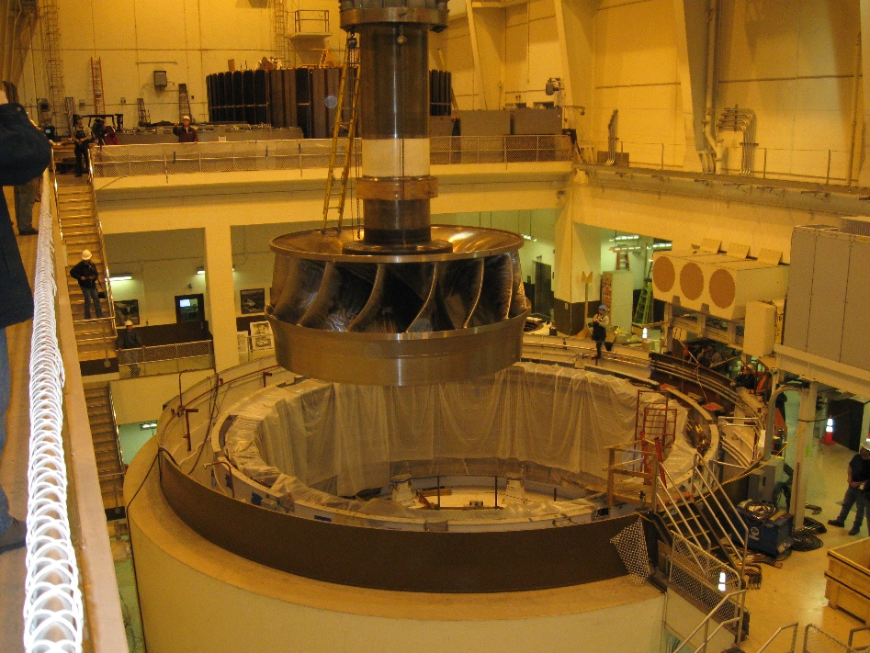
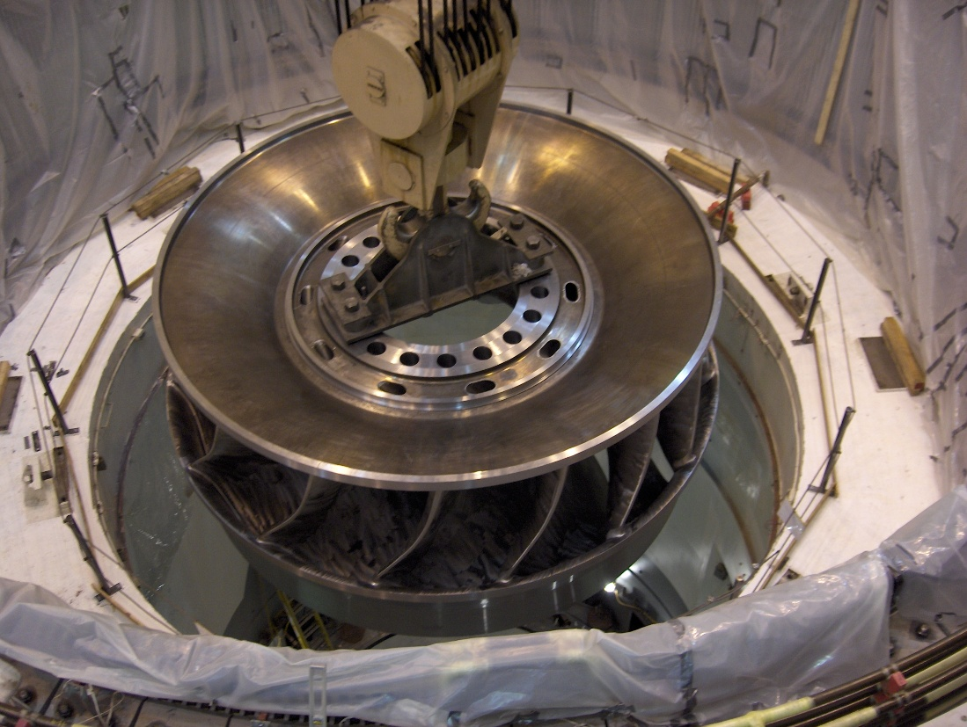
Turbine
Notes:
Here are a couple of photos of the turbines that are in the Mossyrock Generators.
These units were completely rebuilt in 2010 and 2012

Slide 11
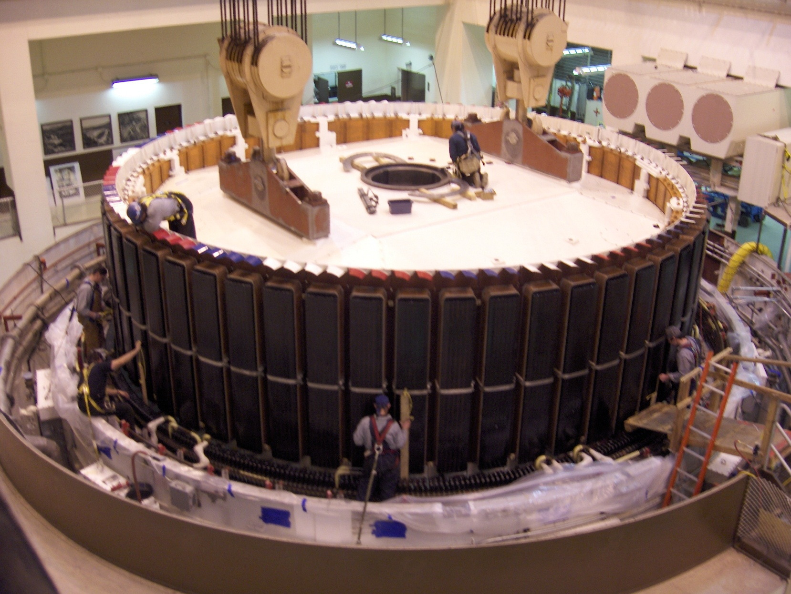
Rotor and Pole Pieces
Notes:
Heres the roto being placing into the stator,
The pole pieces around the outside are about 9 feet tall.
The rotor weighs around 400 tons and spins at 128 RPM’s inside the stator with a ¾ inch gap between them

Slide 12
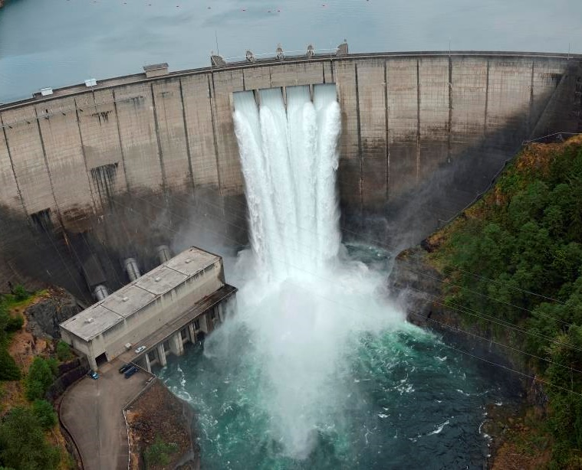
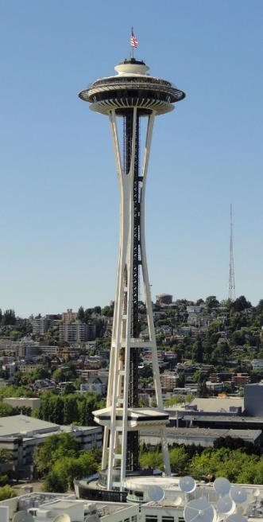
Mossyrock Dam
___________________ is the tallest dam in our state, even taller than the space needle.
Notes:
Mossyrock Dam
Anyone know how tall the space needle is?
606’ from bedrock, one foot taller than the space needle

Slide 13
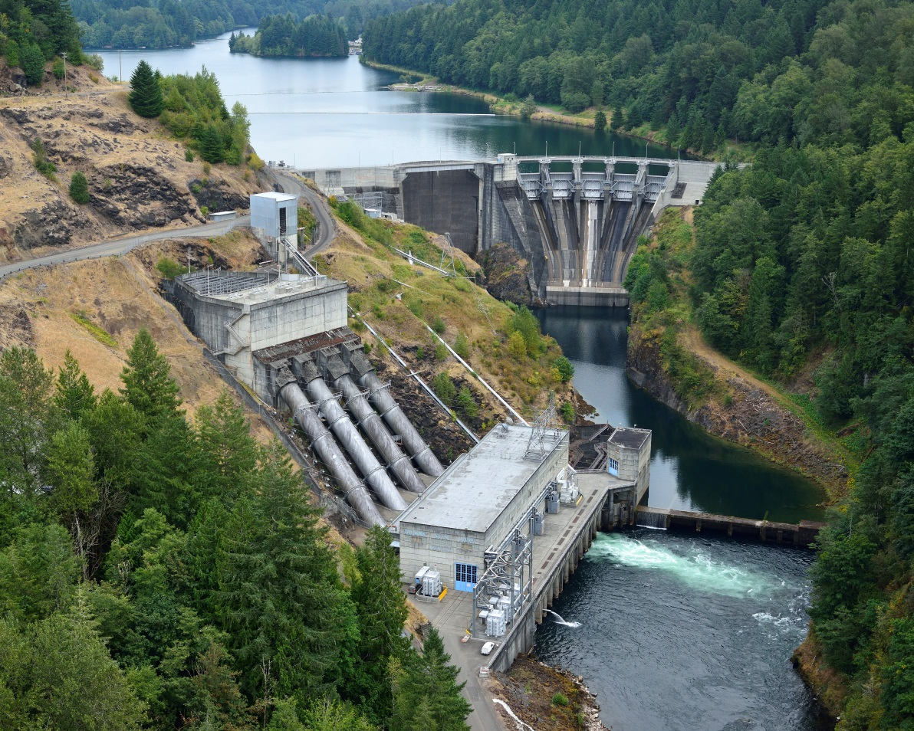
Mayfield Dam and Powerhouse
Notes:
Mayfield Dam and Powerhouse

Slide 14
Generating Resources

Slide 15
How do we evaluate potential new resources? Mashup of Lesson 6b and Tacoma Power Integrated Resources Planning
studentenergy.org/map
Resource |  | Reliability: Net Energy Dispatchability (Capacity) Intermittency/ Uncertainty | Environmental Impacts: Land and Water Carbon/ Global Warming | Cost: Project cost Trends/ future costs Cost uncertainty
Evaluated as a potential new resource by Tacoma Power | Wind
 | Solar
 | Storage (Battery/ Pumped Hydro)
 | Energy Conservation/ Energy Efficiency
Technologies screened out as potential new resource by Tacoma Power | Hydro
 | Nuclear
 | Natural Gas
 | Coal
Fill in this blank table: Rate the resources on a scale of 1-5 for reliability, environmental impacts, and cost and note why. Use your existing understanding augmented with research using the link above.

Slide 16
Integrated Resources Planning

Slide 17
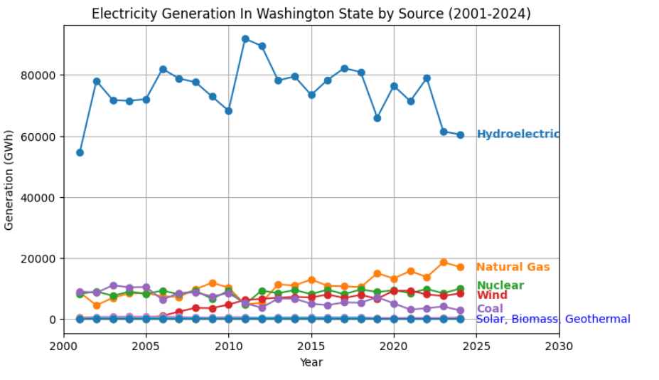
Washington State Energy Portfolio

Slide 18
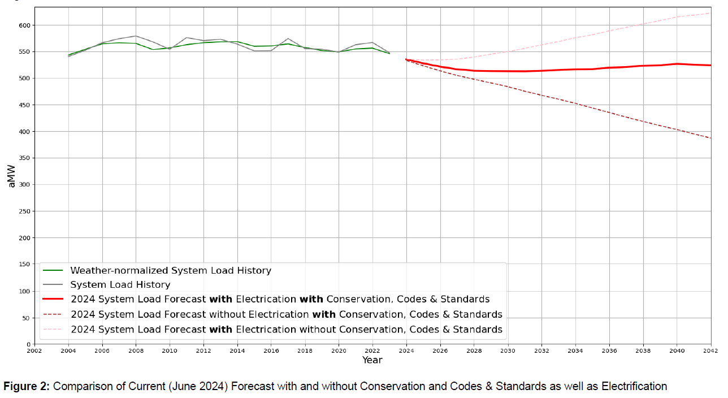
Tacoma Power Load Projections
Cone of uncertainty

Slide 19
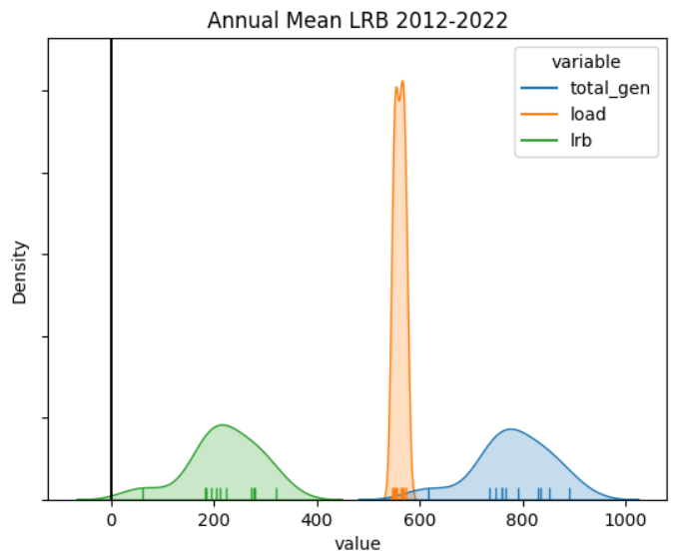
Uncertainty in Supply and Demand at Tacoma Power
Load
Load Resource Balance (Gen – Load)
Generation
Average Megawatts of Power

Slide 20
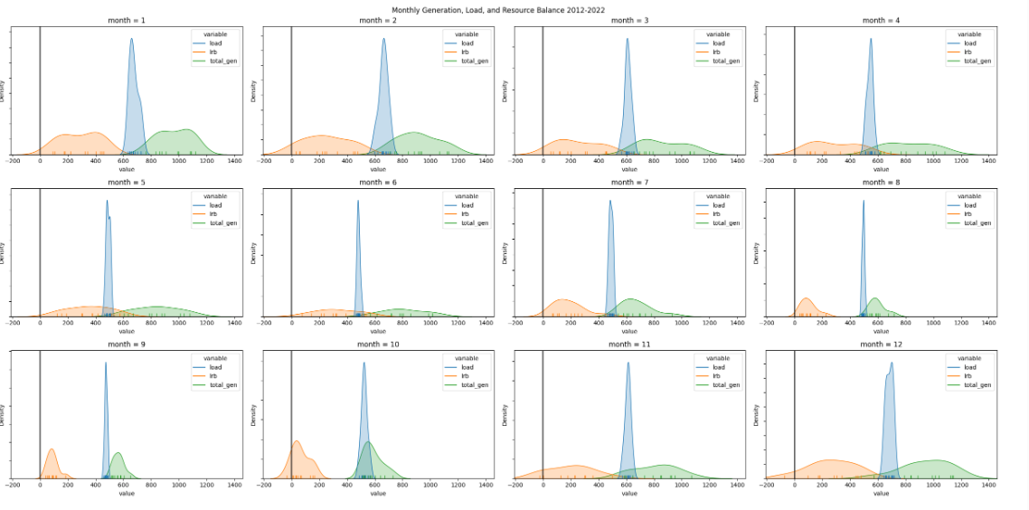
Uncertainty in Supply and Demand at Tacoma Power Through the Year

Slide 21
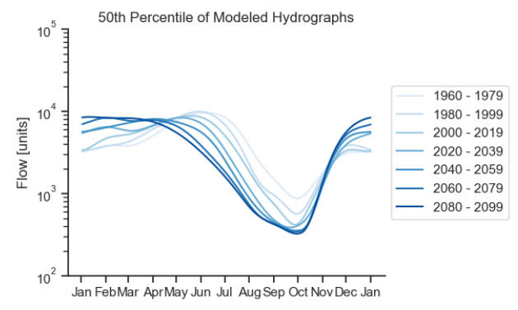
Season Patterns of Inflow and Longterm Seasonal Trends (Climate Change)
Cowlitz River Project Data based on global climate models

Slide 22
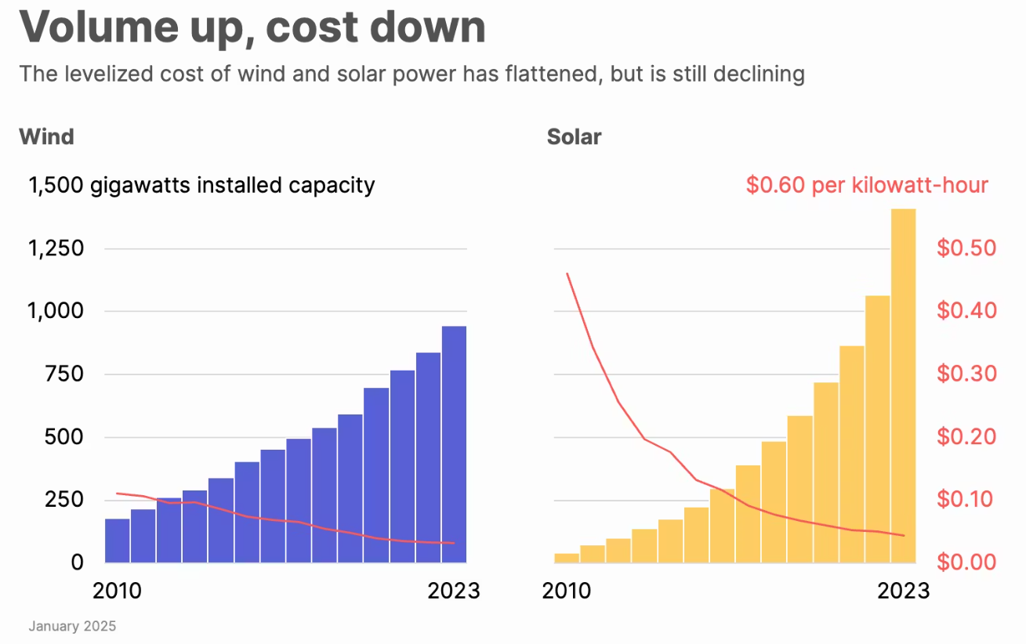
Wind and Solar Trends

Slide 23
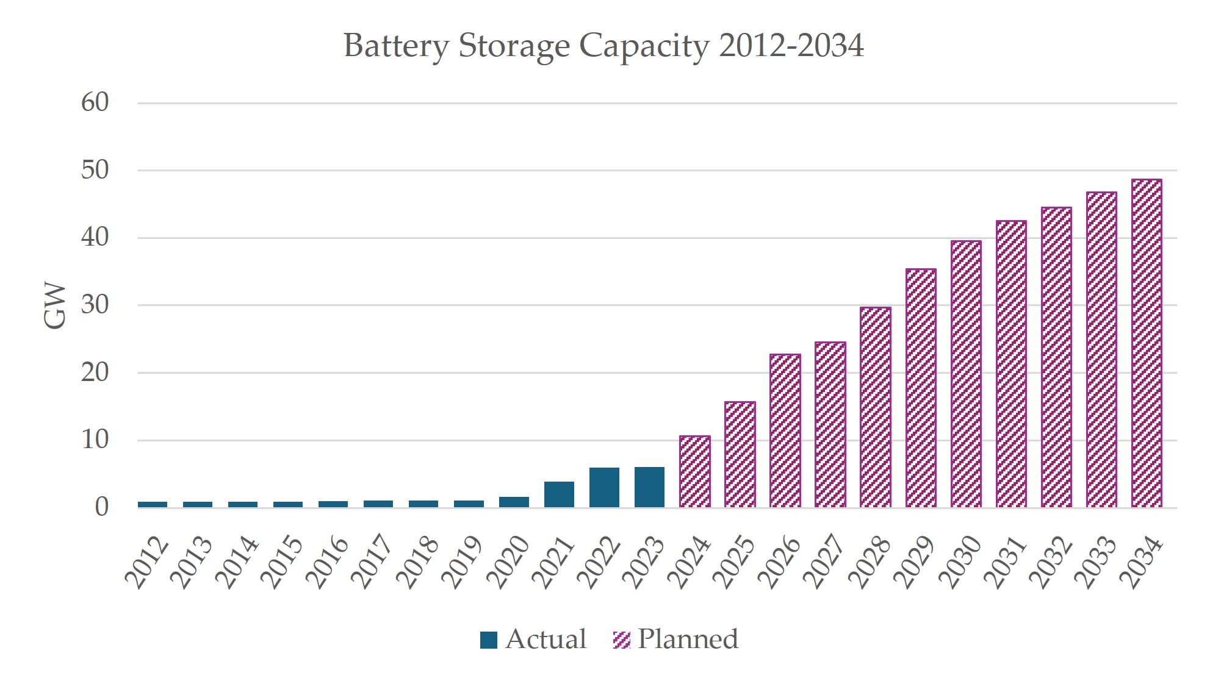
Battery Storage Trends

Slide 24
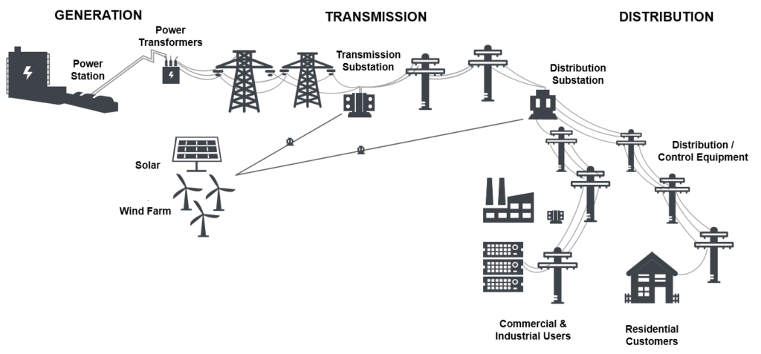
What does “integrated” mean to us?
Supply-side
Resources
Demand-side
Resources
Notes:
“Integrated” has traditionally meant consider both supply and demand side resource
Growing requirements to address transmission planning in IRP, but for us that really means confirming we have the TX and developing a strategy for acquiring it. Unlikely to mean building our own.

